Slide 1


Combining Loads
Revision of 26 February 2026
Dr. Norbert Doerry
http://doerry.org/norbert/MarineElectricalPowerSystems/index.htm
© 2026 by Norbert Doerry
This work is licensed via: CC BY 4.0 (https://creativecommons.org/)

Slide 2
Essential Questions
When can loads be combined into a single load for the EPLA? | Understand
How does one identify loads that can be combined and then combine them? | Apply
How does one manage a load that has been combined as detail is refined in the design? | Understand

Slide 3
Introduction
Proxy Loads
Proxy loads may represent a group of loads used …
  When details of the actual loads are not known, or
  When convenient for modeling purposes
    Many smaller loads
    Modeling does not require individual loads to be modelled.
Important to clearly identify what the proxy load represents and associated assumptions.
  As design matures, may be beneficial to remove specific loads from the proxy load and model independently
    Need to understand how to adjust proxy load characteristics to account for the removal of the specific load
Time range of interest impacts modeling proxy loads
  Short time range (seconds to minutes) typically used for equipment sizing
    ~5 seconds used for power electronic based sources
    ~ 5 minutes used for generator-based sources
  24 hours used for 24-hour average calculations.

Slide 4
Conditions for combining loads
Loads have the same connections to the power system for the purpose of the analyses
  Depends on what level of distribution is being modeled
    Power panel
    Load center
    Switchboard
For the load list, the loads should have the same product breakdown structure identifier
  SWBS for US naval ships
  A variety of taxonomies for commercial ships
  Not required if proxy only created for purpose of simplifying a particular analysis model
Two loads that are mutually exclusive, but with same connections to the power system
  May simplify load modeling to combine them in a proxy load
  Only the “worst-case” load is used for short time range of interest
  Both are used for calculating 24-hour averages

Slide 5
Examples of load categories to consider for combining into proxy loads
Electric lighting
Electric heaters
Fan coil units
Ventilation fans
Galley equipment
Convenience outlets
Windshield wipers
Data acquisition units
Distributed network equipment
Distributed internal communications equipment
Water coolers (drinking fountains)
Radio equipment
Medical and dental equipment
Laundry equipment

Slide 6
Load List nuances
Location on the ship: May be left blank if the constituent loads are not collocated.
Identification Plate (nameplate) rating (including units): May be left blank.
Connected Load (kW and KVAR): Use the sum of the connected loads of the constituent loads.
Peak Load (kW and KVAR): If the peak load does not differ substantially from the average load, use the average load; otherwise consider using quasi-steady-state analysis or the zonal load factor method to estimate the peak load. One can also use engineering judgement based on knowledge of the loads and their usage to estimate the peak load.
Load behavior: Use the load behavior that best matches the combination of all the constituent loads.
Use during different ship operating conditions: For a given operating condition and ambient condition, if any of the constituent loads are on, then should use TRUE. If all of the constituent loads are off, then should use FALSE. Otherwise use UNKNOWN.
In-rush current demand: Should be the worst case for the group of loads.
Temperature dependence: If any of the constituent loads have a temperature dependence, then should be set to TRUE. If all of the constituent loads do not have a temperature dependence, then should be set to FALSE. Otherwise, set to UNKNOWN.
Tolerance to power interruptions: The lowest tolerance to power interruptions for the group of loads should be used. If only a few loads have a very low tolerance, one should consider moving these loads to their own proxy load; otherwise, the impact on the power system of providing a higher QOS level than needed could be significant.
Load shed priority (mission priority): Should use the highest priority of any one load within the group of loads. If only a few loads have a very high priority, one should consider moving these loads to their own proxy load.

Slide 7
Load factors for load factor analysis
(short time range of interest)
Quasi-steady state simulation of all constituent loads
  If the loads are pulsed, cyclic, multi-mode, or not continuously on, and partially or completely coordinated via coordinated control action or other means.
  At each point in time, the average of the power consumed by the loads over the previous time range of interest is calculated.
  The load factor is the highest value of this average divided by the proxy load’s connected load.
Quasi-steady state simulation of individual loads
  If the loads are pulsed, cyclic, multi-mode, or not continuously on, and not coordinated via control action or other means.
  Quasi-steady state simulation is used to determine the highest average consumed by each load over the time range of interest.
  The load factor of the proxy load is the sum of the highest average of the loads divided by the proxy load’s connected load.
Use of zonal load factor method
  Only requires 24-hour average load factor, peak power, and connected load for each constituent load.
  Combine using zonal load factor method
  The load factor of the proxy load is the zonal total operating load divided by the proxy load’s connected load.
Combining individual load factors
  Appropriate if all the constituent loads draw relatively constant power.
  The sum of the individual load factors multiplied by the individual load connected loads is calculated
  This sum is divided by the proxy load’s connected load to obtain he proxy load’s load factor.

Slide 8
Load factors for load factor analysis
(24 hour time range of interest)
Sum estimates of energy (kWh) consumed by each constituent load over 24 hours.
Proxy load factor is the sum divided by 24 and the proxy load’s connected load.
Energy consumed by a constituent load may be estimated several ways:
  Quasi-steady state analysis may be used, or
  Analogy to other ships, or
  Default load factors from IEEE Std 45.1 or DPC 310-1.

Slide 9
Peak load for zonal load factor analysis
Zonal load factor method requires for the proxy load …
  24-hour average load factor (from load factor analysis)
  Connected load (sum of connected loads of constituent loads)
  Peak Load
Peak Load estimation for a proxy load methods:
  Sum peak loads of all constituent loads; likely too conservative
  Quasi-steady state load analysis; use highest sum of all constituent loads across the simulation time period
  Use zonal load factor analysis on all constituent loads; peak load for the proxy load is the zonal total operating load

Slide 10
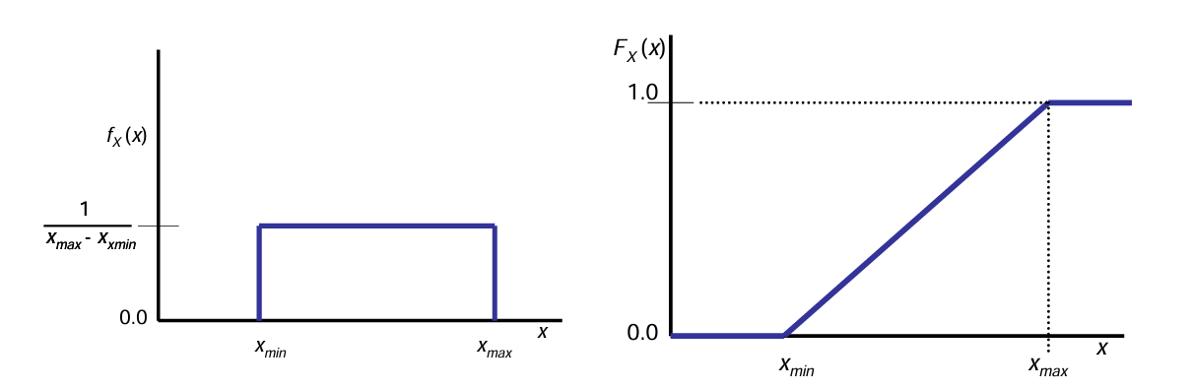
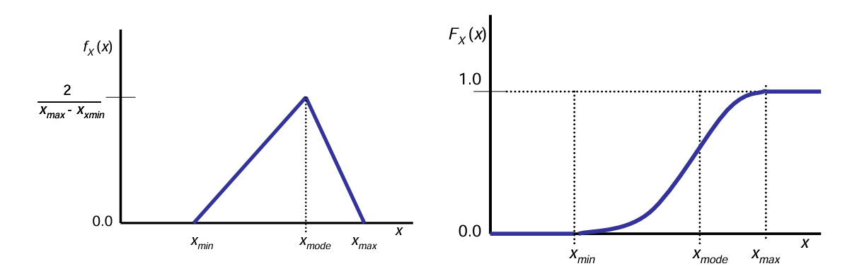
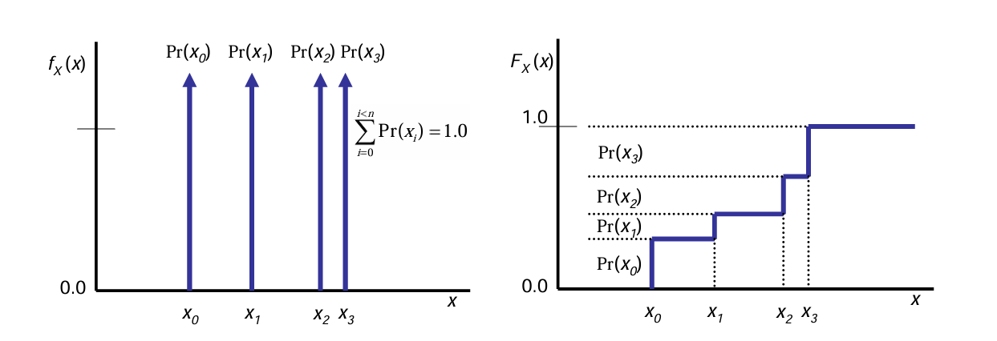
Combining stochastic models
Model each constituent load as a probability density function (PDF) from which a cumulative density function (CDF) can be calculated.
Use Monte Carlo simulation methods to estimate the PDF (and CDF) for the sum of all the constituent loads
See DPC 310-1 for details

Slide 11
Combining load simulation models
Simulation models typically quasi-steady state models based on the time range of interest.
Constructing a simulation model of a proxy load depends on:
  Interdependency of the loads
  Control inputs
  Time range of interest
Simulation models for proxy loads should be designed for easy modification when constituent loads are removed as part of the design process.

Slide 12
Managing proxy loads
In early stages of design, the entire load list could be composed of proxy loads based on:
  Equipment on a similar ship.
  Parametric equations.
Proxy loads should enable breaking out constituent loads as they are defined.
During detail design, all (virtually all) proxy loads should be replaced with the actual equipment that will be installed on the ship.
Proxy loads may be used in specific analysis to group multiple loads that have the same connection to the power system.
  Enable analysis to be conducted faster.

